Slide 1


Digital Low Pass Filter
Tom Zimmerman
IBM Research-Almaden
4.18.23
This material is based upon work supported by the NSF under Grant No. DBI-1548297.
Disclaimer: Any opinions, findings and conclusions or recommendations expressed in this material are those of the authors and do not necessarily reflect the views of the National Science Foundation.

Slide 2
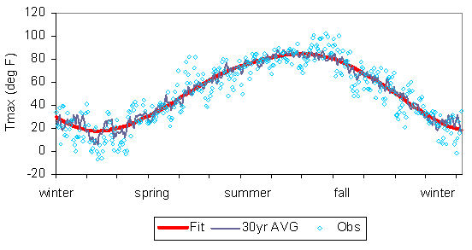
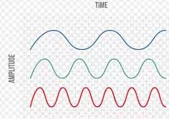
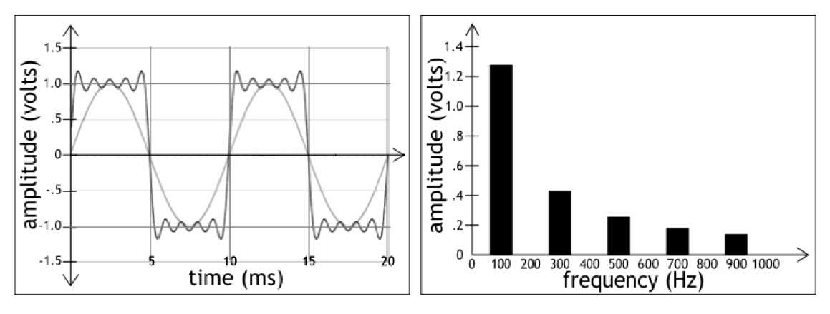
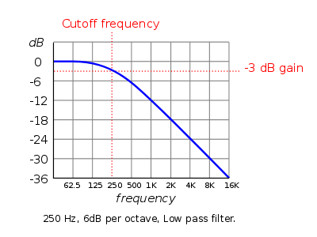
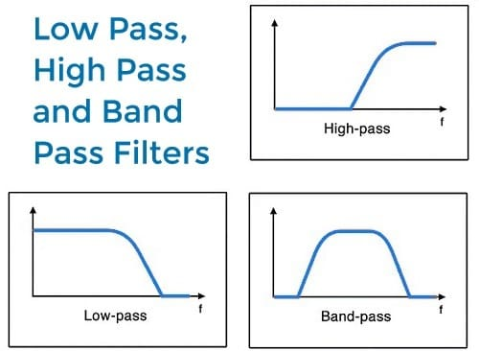
Represent Signal in Time and Frequency Domain
Low Pass Filtering of Noisy (High Frequency) Data
A
B
C
Amplitude
Frequency
Any Waveform Synthesized from Sum of Sine Waves
amp=1/n (1, 1/3, 1/5...)
odd harmonics
(1,3,5,... x fundamental freq)
Cutoff Frequency of Low Pass Filter
LOG UNITS
octave=2*frequency
6dB=2*amplitude
-6dB=0.5*amplitude
Types of Filters

Slide 3
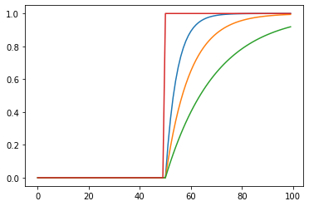
One-Pole (-3dB/octave) Digital Low Pass Filter
S_{out} = f_{c} * S_{out} + (1- f_{c})S_{in}
f_{c} = 0.0 to 1.0
Larger fc value means lower cutoff frequency i.e., less noise but more lag. Suggestions: Start with 0.9. Initialize Sout=Sin
f_{c} =
f_{c} =0.8
f_{c} =0.9
f_{c} =0.95

Slide 4
import numpy as np
import matplotlib.pyplot as plt
MAX_SAMPLES=100
f1=0.8
f2=0.9
f3=0.95
s=np.zeros(MAX_SAMPLES)
S1=np.zeros(MAX_SAMPLES)
S2=np.zeros(MAX_SAMPLES)
S3=np.zeros(MAX_SAMPLES)
s[int(MAX_SAMPLES/2):MAX_SAMPLES]=1
S1[0]=s[0] # bootstrap output with first sample
S2[0]=s[0] # bootstrap output with first sample
S3[0]=s[0] # bootstrap output with first sample
for i in range(1,MAX_SAMPLES-1):
S1[i+1] = f1*S1[i] + (1-f1)*s[i]
S2[i+1] = f2*S2[i] + (1-f2)*s[i]
S3[i+1] = f3*S3[i] + (1-f3)*s[i]
plt.plot(S1)
plt.plot(S2)
plt.plot(S3)
plt.plot(s)

